Slide 1
IBM University Engagement Project Submission
“Exploring the Power of Agentic AI with IBM Cloud and Orchestrate”

Slide 2

Project Tile – [AI Legal Aid Multi-Agent System]
Domain of Project – [Legal Technology]
Student Name | Recent Passport Photo | Email ID | Mobile number [WhatsApp]
Mohammed Umeir Patel |  | umeirp3636@gmail.com | 9373597210

Slide 3
Problem Statement - AI Legal Aid Multi-Agent System
The Challenge
The proposed solution for the AI Legal Aid Multi-Agent System is to design an intelligent, interactive platform that simplifies access to legal information, document analysis, and compliance guidance for individuals and small businesses. The assistant will integrate IBM Langflow, IBM Orchestrate, and IBM Models to create a unified legal support system. Knowledge retrieval will be handled through Langflow pipelines, which ingest and semantically search legal documents, statutes, regulations, contracts, and case law to provide accurate and context-aware information. Legal concept explanation will be powered by IBM Models, delivering responses in simple, easy-to-understand language while also providing detailed legal insights for advanced users, making legal knowledge accessible to everyone. Document analysis and specialized legal support will be coordinated through IBM Orchestrate, enabling multiple AI agents to review contracts, identify risks, verify compliance with applicable regulations, conduct case research, and answer user-specific legal queries. Finally, a conversational interface will allow users to interact naturally with the assistant by asking legal questions or uploading legal documents, receiving structured summaries, highlighted clauses, compliance recommendations, and relevant legal references. This solution will reduce the time and effort required to understand legal information, improve awareness of legal rights and obligations, and provide practical legal guidance while clearly informing users that the system is intended for informational purposes only and is not a substitute for professional legal advice.

Slide 4
Proposed Solution -
Proposed Solution: AI Legal Aid Multi-Agent System
The proposed solution for the AI Legal Aid Multi-Agent System is to design an intelligent, interactive platform that simplifies access to legal information, document analysis, and compliance guidance for individuals and small businesses. The assistant will integrate IBM Langflow, IBM Orchestrate, and IBM Models to create a unified legal support platform. Legal knowledge retrieval will be handled by Langflow pipelines, which ingest and semantically search legal statutes, regulations, contracts, policies, and case law to provide accurate, context-aware information. Legal concept explanation will be powered by IBM Models, delivering responses that range from beginner-friendly summaries to detailed legal interpretations, making complex legal concepts easy to understand for users with varying levels of legal knowledge. Document analysis and workflow automation will be managed through IBM Orchestrate, enabling specialized AI agents to review contracts, identify risky clauses, verify regulatory compliance, answer user-specific legal questions using Retrieval-Augmented Generation (RAG), and research relevant case precedents. Finally, a conversational interface will allow users to interact naturally with the assistant by asking legal questions or uploading legal documents, receiving structured summaries, highlighted clauses, compliance recommendations, and relevant legal references through an intuitive dashboard. This solution will reduce the time and cost associated with obtaining basic legal guidance, improve understanding of legal rights and obligations, assist users in identifying potential legal risks, and make legal information more accessible while clearly stating that the assistant provides informational support and is not a substitute for professional legal advice.

Slide 5
Technology Used
IBM Orchestrate -
Automates guided troubleshooting flows.
Provides diagnostic support for satellite communication issues.
Helps users follow structured problem-solving steps.
IBM Models
Powers natural language understanding.
Generates simplified explanations of complex concepts (modulation, frequency bands, link budgets).
Offers layered responses for both beginners and advanced learners.
IBM Watsonx.ai - For model deployment, embeddings, and AI governance

Slide 6
Orchestrate component Used -
1) Chat Input – Interface where users enter their queries about satellite communication (text/voice).
2) IBM watsonx AI Agent - Processes user input using Granite models to generate satellite communication and recommendations.
3) Name of IBM Granite model - Granite-4.0-8B-Instruct → Fast, efficient for real-time satellite communication recommendations
Document Loader – Loads textbooks, research papers, and technical documentation into the system for knowledge ingestion.
LLM Chain – Connects the language model with retrieved knowledge to generate simplified explanations of complex concepts.
Conversational Chain – Maintains context across multiple queries, enabling interactive and session-based responses.
Prompt Template – Structures user queries for consistent processing and ensures domain-specific responses.
Output Parser – Formats AI-generated responses into user-friendly text, diagrams, or troubleshooting steps.

Slide 7
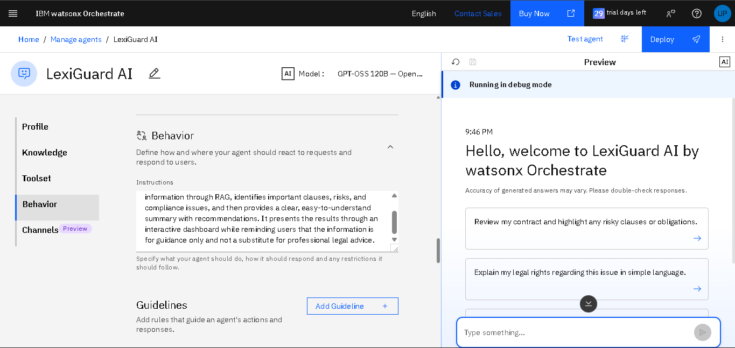
Agent Instructions Screenshot-

Slide 8
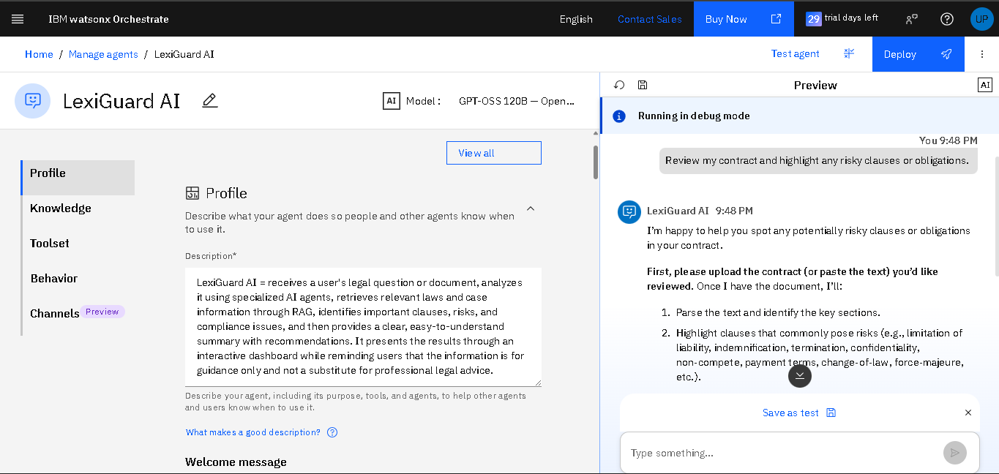
Prompt with output Screenshot:

Slide 9
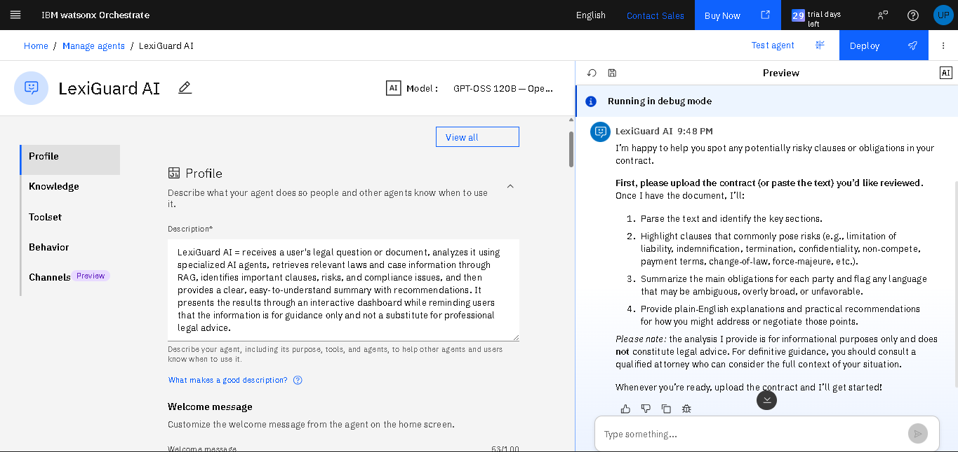
Prompt with output Screenshot:

Slide 10
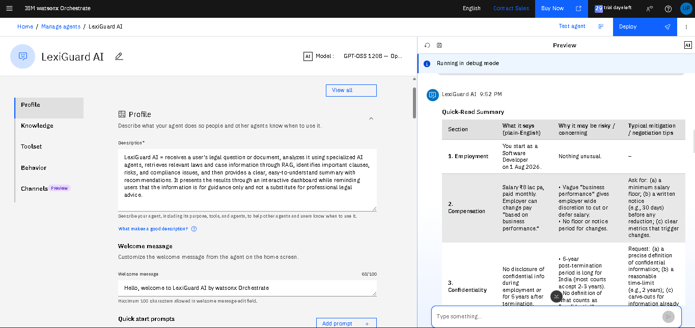
Prompt with output Screenshot:

Slide 11
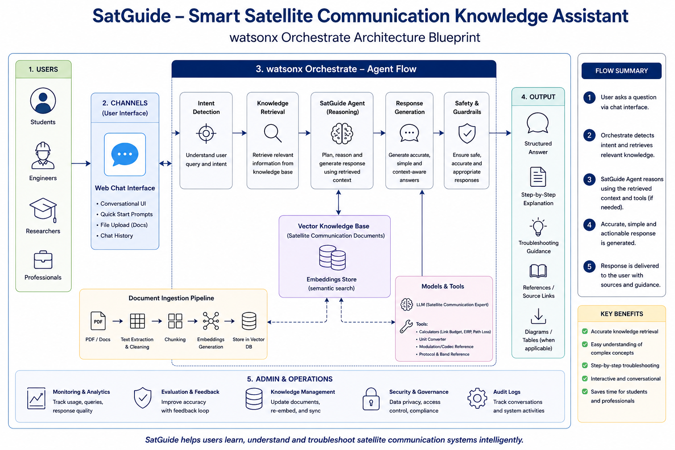
Orchestrate architecture blueprint

Slide 12

Role of Agentic AI in the solution
Role of Agentic AI in AI Legal Aid Multi-Agent System
The role of Agentic AI in the AI Legal Aid Multi-Agent System is to make the platform proactive, intelligent, and collaborative rather than simply responding to user queries. It autonomously retrieves relevant legal information, coordinates specialized AI agents, analyzes legal documents, and delivers context-aware guidance while maintaining the flow of the conversation.
Legal Knowledge Retrieval – Actively searches and prioritizes the most relevant laws, regulations, legal precedents, and case judgments using Retrieval-Augmented Generation (RAG).
Contract Review & Risk Analysis – Automatically analyzes contracts and legal documents to identify risky clauses, obligations, inconsistencies, and ambiguous language.
Compliance Verification – Evaluates uploaded documents against applicable laws and regulations, identifies compliance gaps, and suggests corrective actions.
Case Research & Decision Support – Retrieves relevant court cases, legal precedents, and regulatory references to provide users with accurate, context-aware legal insights and recommendations.
Conversational Legal Assistance – Maintains context throughout multi-turn conversations, explains legal concepts in simple language, asks clarifying questions when necessary, and provides structured guidance while clearly stating that the information is for educational purposes only and not a substitute for professional legal advice.

Slide 13
Novelty and Uniqueness
Novelty and Uniqueness of the AI Legal Aid Multi-Agent System
The novelty and uniqueness of the AI Legal Aid Multi-Agent System lies in transforming complex legal information into an intelligent, interactive, and accessible platform for legal guidance and document analysis.
Unified Legal Retrieval – Consolidates laws, regulations, contracts, and case judgments into one AI-powered platform using RAG.
Smart Document Analysis – Reviews contracts and policies, highlighting key clauses, obligations, and potential legal risks automatically.
Agentic Legal Assistance – Coordinates specialized AI agents for contract review, compliance checks, legal research, and user-specific Q&A.
Context-Aware Conversations – Maintains conversation context, explains legal concepts in simple language, and provides personalized guidance.

Slide 14
Git Hub Link
https://github.com/umeirp3636-ux/AI-Legal-Aid-Multi-Agent-System
·
·
·

Slide 15
Future Scope
Advanced AI Integration – Leveraging more powerful IBM Granite models for deeper legal reasoning, case analysis, and contextual legal assistance.
Multimodal Support – Expanding beyond text to support voice queries, document scanning, and image-based legal document analysis.
Personalized Legal Guidance – Tailoring responses and recommendations based on user profiles such as individuals, businesses, students, or legal professionals.
Real-Time Legal Updates – Integrating with live legal databases to provide the latest laws, regulations, court judgments, and policy changes.
Government & e-Governance Integration – Connecting with digital government services for document verification, legal forms, and citizen support.
Global Legal Knowledge – Supporting multiple jurisdictions and languages to provide legal assistance across different countries.
Continuous Knowledge Expansion – Automatically updating the knowledge base with new legislation, judicial precedents, and legal research publications.
·
·
·

Slide 16
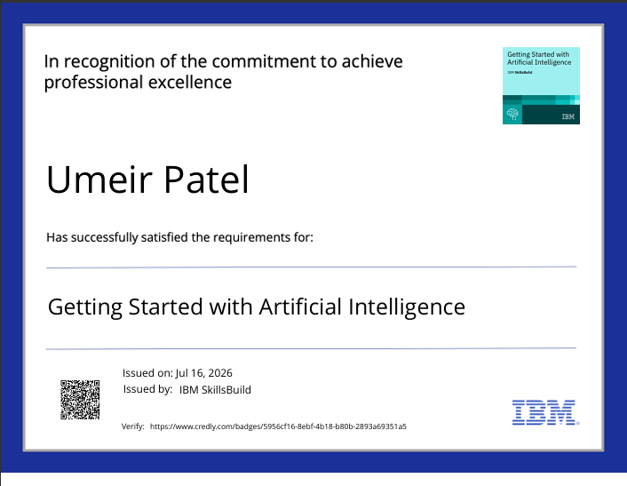
Certificates Earned:

Slide 17
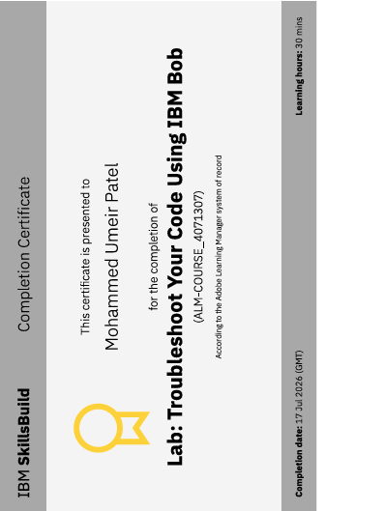
Certificates Earned:​

Slide 18


